Slide 1


Research on hyperparameters for the
classification of ultrasonic signals
By:
Theertha Bharathan(1445457)

Slide 2
Contents
01
Introduction
03
Implementation
Data Preprocessing
02
Methodology
Machine Learning Models
Sensor System and Red Pitaya Board
04
Results
Ultrasonic Object Differentiation
Hyperparameter Optimization
05
Conclusion

Slide 3
Introduction
The objective of the study is to examine how different machine learning model for ultrasonic signal classification are affected by hyperparameter tuning. The study analyses how hyperparameter adjustment can increase the models’ capacity to distinguish between different materials based on ultrasonic waves the reflect.

Slide 4
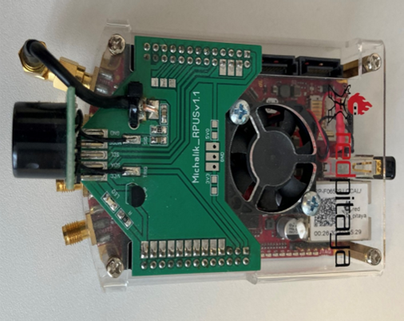
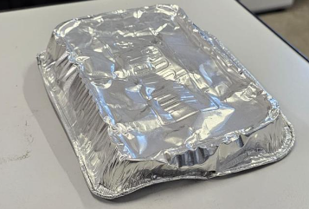
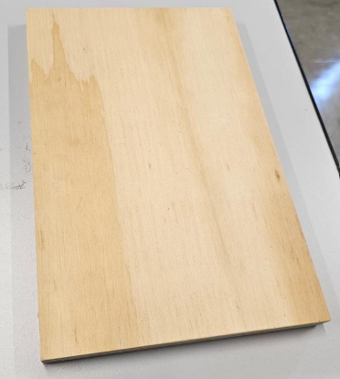
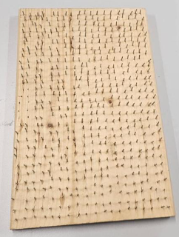
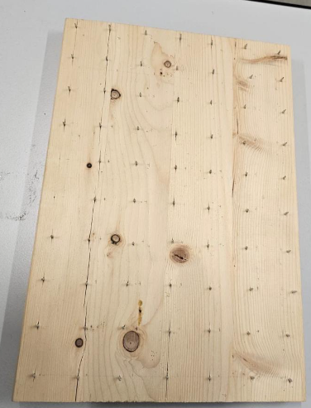
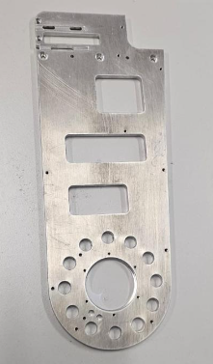
Methodology
Sensor System and Red Pitaya Measurement Board
Red Pitaya
Aluminium
Plain wood
Wood with lots of needles
Wood with less needles
Steel

Slide 5
Methodology
Ultrasonic Object Differentiation
Time-of-Flight (ToF) Principle
Pulse-Echo Method
Phase Shift Measurement
Multi-Echo Detection
Dual-Transducer Systems
Temperature Compensation

Slide 6
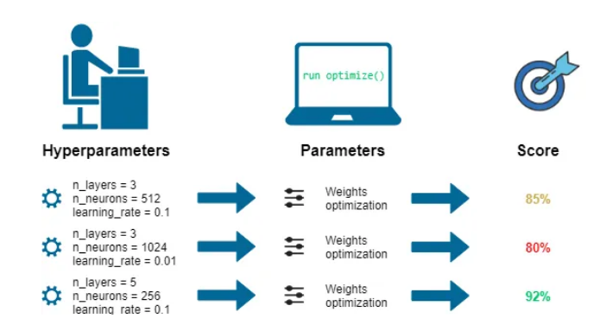
Methodology
Hyperparameter Optimization
Hyperparameters = are all the parameters which can be arbitrarily set by the user before starting training (eg. number of estimators in Random Forest).

Slide 7
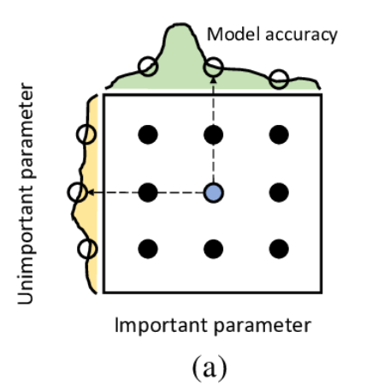
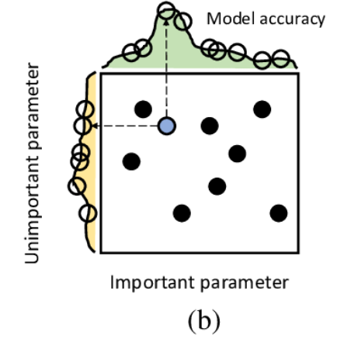
Methodology
Hyperparameter Optimization Techniques
Grid Search:
This approach is a brute-force technique that searches over the hyperparameter space of the learning algorithm in a predetermined subset. To speed up the search, the technique can be parallelized among several models with various configurations.
Random Search:
This approach chooses random values from the hyperparameter subset independently. By navigating the grid of hyperparameters randomly, one can obtain a similar performance as a full grid search. However, this approach is surprisingly easy and effective.

Slide 8
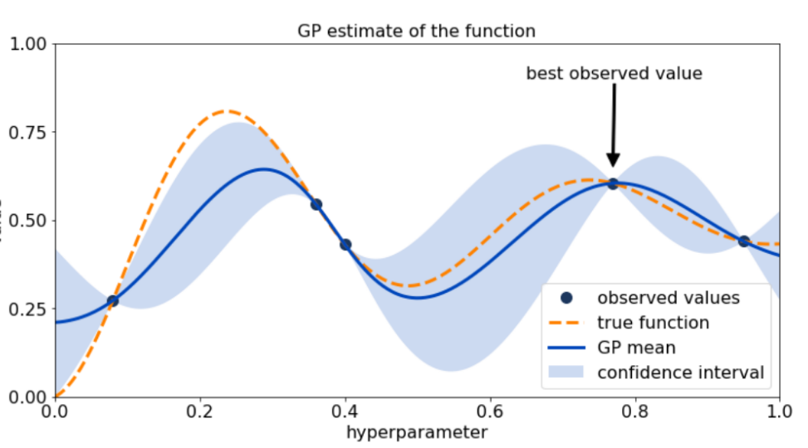
Methodology
Hyperparameter Optimization Techniques
Bayesian optimization:
This approach builds a surrogate model based on a random selection of hyperparameters and forecasts the performance of more combinations. To reduce the objective function, it strikes a balance between exploration and exploitation
Hyperband Search: exploitation Hyperband efficiently explores many hyperparameter configurations by allocating limited resources initially and increasing them for top performing ones. It balances exploration of a wide range of options with a focus on the best configurations, optimizing both time and performance.

Slide 9
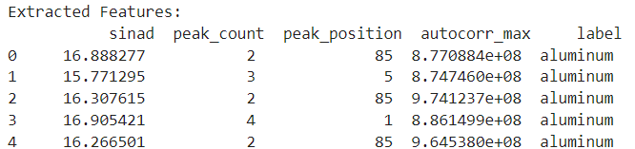
Implementation
Data Preprocessing for Model Training
Windowing to Reduce Spectral Leakage
Fourier Transform (FFT) for frequency analysis of signals
Extracting SINAD, peak (count, position) , and autocorrelation

Slide 10
Implementation
Machine learning Models
ML Models
KNN
SVM
Random Forest
MLP
CNN
LSTM

Slide 11
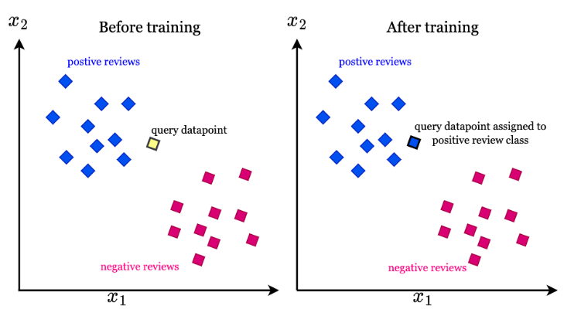
Results
K-Nearest Neighbours (KNN)
KNN classifies data points by looking at the 'k' closest training examples in the feature space. It is simple to implement and effective for small datasets but can struggle with high-dimensional data.

Slide 12
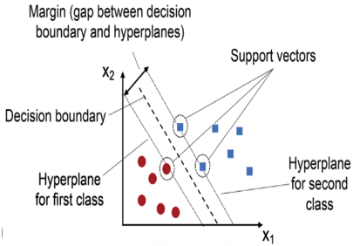
Results
Support Vector Machines (SVM)
SVM creates a hyperplane that best separates different classes in the feature space, maximizing the margin between them. It is particularly effective in high-dimensional spaces and is robust against overfitting.

Slide 13
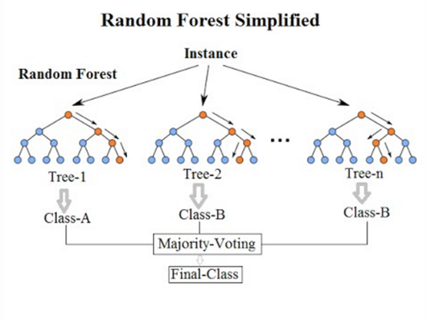
Implementation
Random Forest
Random Forest is an ensemble learning method that constructs multiple decision trees during training and outputs the mode of their predictions. This approach enhances accuracy and reduces the risk of overfitting compared to individual decision trees.

Slide 14
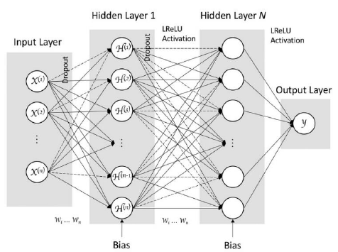
Implementation
Multilayer Perceptron (MLP)
MLP is a type of feedforward neural network that consists of multiple layers of neurons, enabling it to learn complex patterns in data. It uses backpropagation for training, making it suitable for various classification and regression tasks.

Slide 15
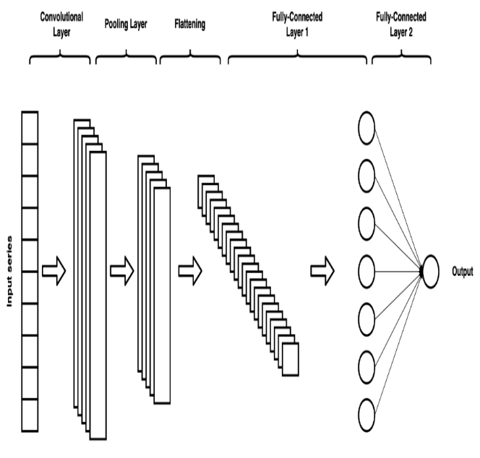
Implementation
Convolutional Neural Networks (CNN)
CNNs are specialized neural networks designed for processing structured grid data, such as images, by using convolutional layers to automatically extract features. They excel in tasks like image recognition and classification due to their ability to capture spatial hierarchies

Slide 16
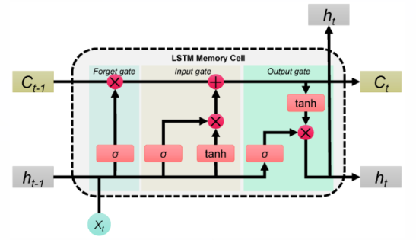
LSTMs are a type of recurrent neural network (RNN) that can learn long-term dependencies in sequential data, making them ideal for time series analysis and natural language processing. Their unique architecture helps prevent issues like vanishing gradients, allowing them to retain information over longer sequences.
Implementation
Long Short-Term Memory (LSTM)
LSTM’s are type of recurrent neutral networks (RNN) that can learn long dependencies in sequential data, making them ideal for time series analysis and natural language processing. Their unique architecture helps prevent issues like vanishing gradients, allowing them to retain information over longer sequences.

Slide 17
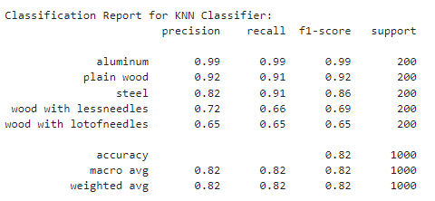
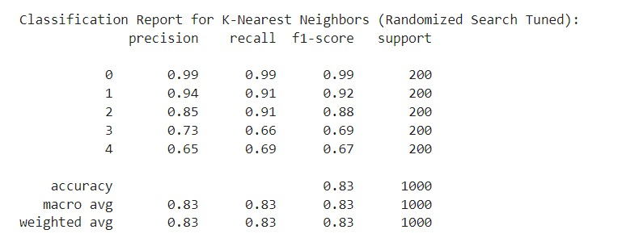
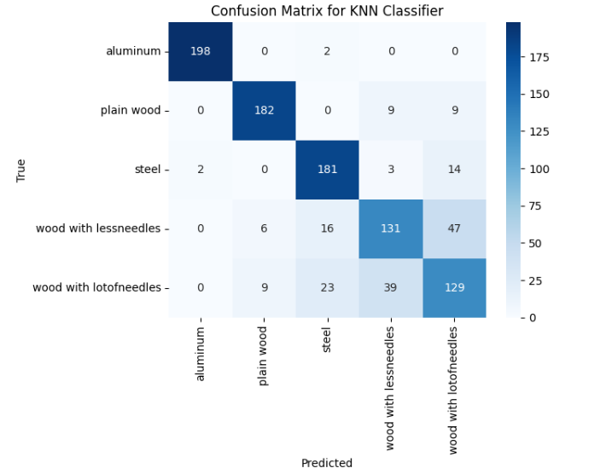
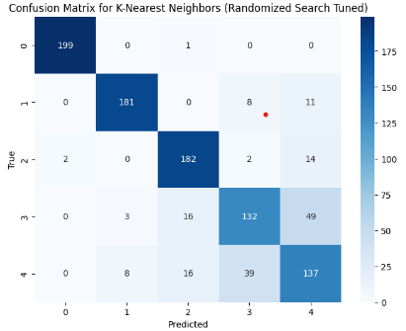
Results
K-Nearest Neighbours (KNN)

Slide 18
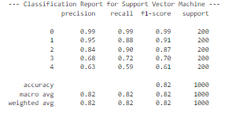
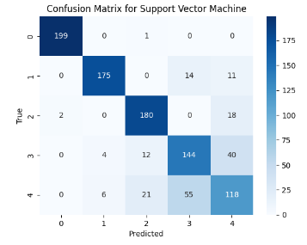
Results
Support Vector Machines (SVM)

Slide 19
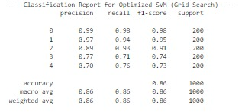
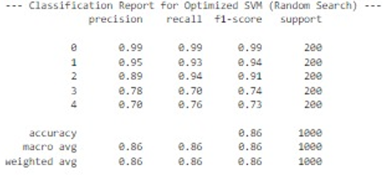
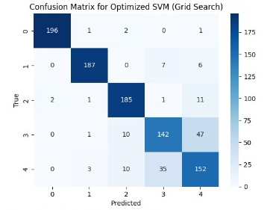
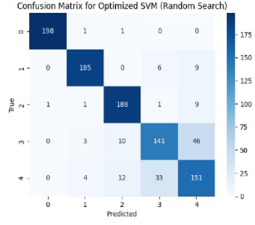
Results
Support Vector Machines (SVM)

Slide 20
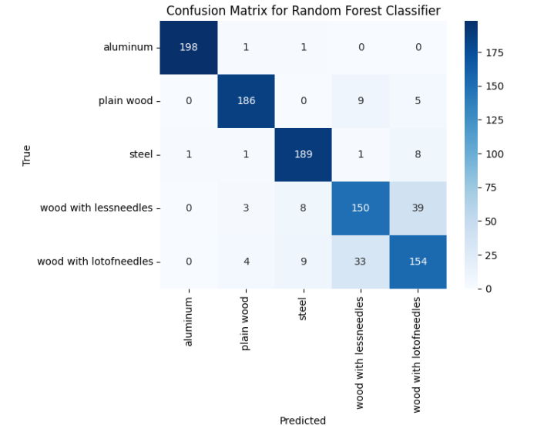
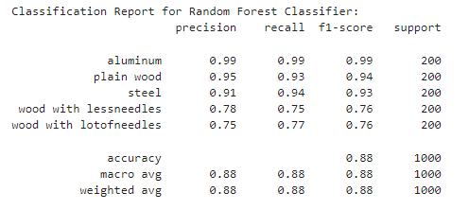
Results
Random Forest (without hyperparameter tuning)

Slide 21
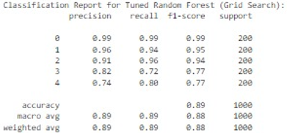
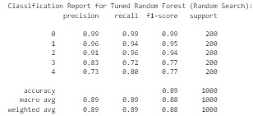
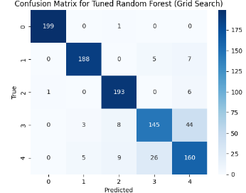
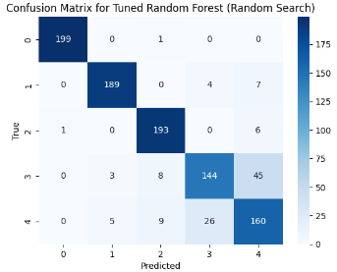
Results
Random Forest

Slide 22
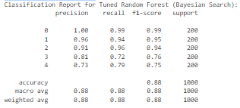
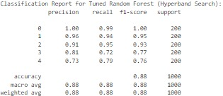
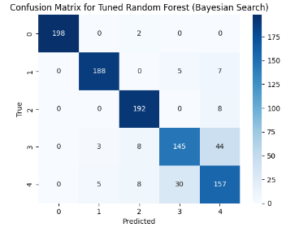
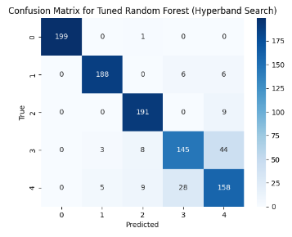
Results
Random Forest

Slide 23
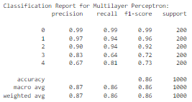
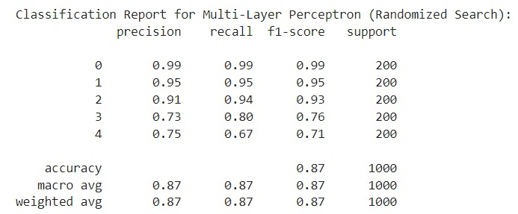
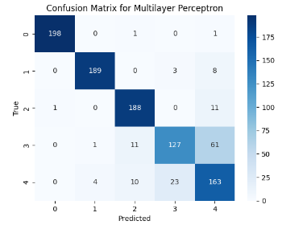
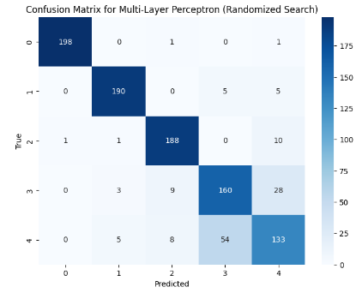
Results
Multilayer Perceptron (MLP)

Slide 24
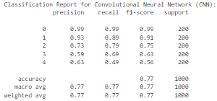
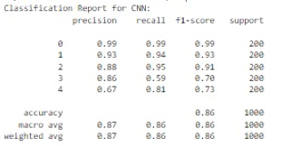
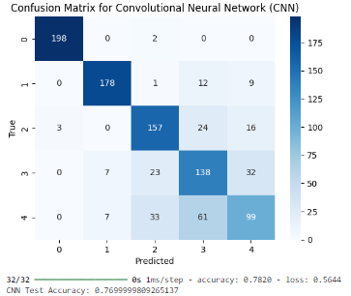
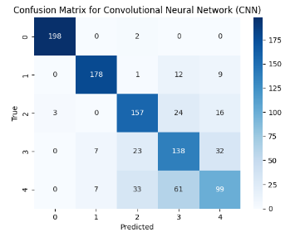
Results
Convolutional Neural Networks (CNN)

Slide 25
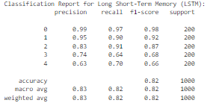
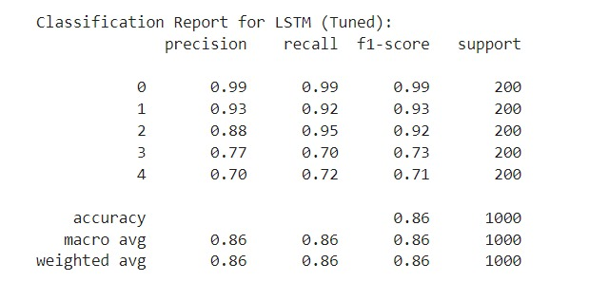
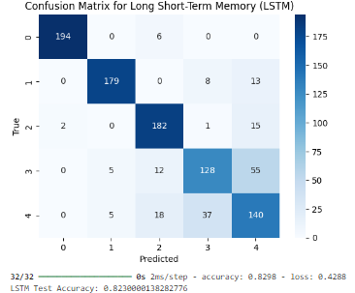
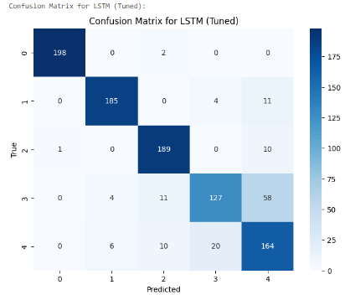
Results
Long Short-Term Memory (LSTM)

Slide 26
Conclusion
Analysis of Ultrasonic Signal Classification
Impact of Hyperparameter Tuning
Key Takeaways
Models performed much better after hyperparameter adjustment, which increased their capacity to differentiate across materials.
Random Forest showed the best classification accuracy.
The integration of machine learning with feature extraction methods produced insightful results about material differentiation.
Optimizing model performance has been shown to depend heavily on tuning parameters like estimators and kernels.
Several machine learning models have been successfully constructed to categorize materials using ultrasonic signals that are obtained by the SRF02 sensor and the Red Pitaya STEMLAB

Slide 27
Thank You

